Slide 1
myDRE
Activity

Slide 2
Definitions
ACTIVTY is measured via:
Start Virtual Machine Succeeded
Ignores INGRESS and EGRESS activities
Ignores people entering a running Virtual Machine
Ignores Virtual Machines with autoshutdown=False
I.e., actual activity can be higher
Collaborations – who collaborates with us, who are we collaborating with
Removed all anDREa people
Tenant’s own people

Slide 3
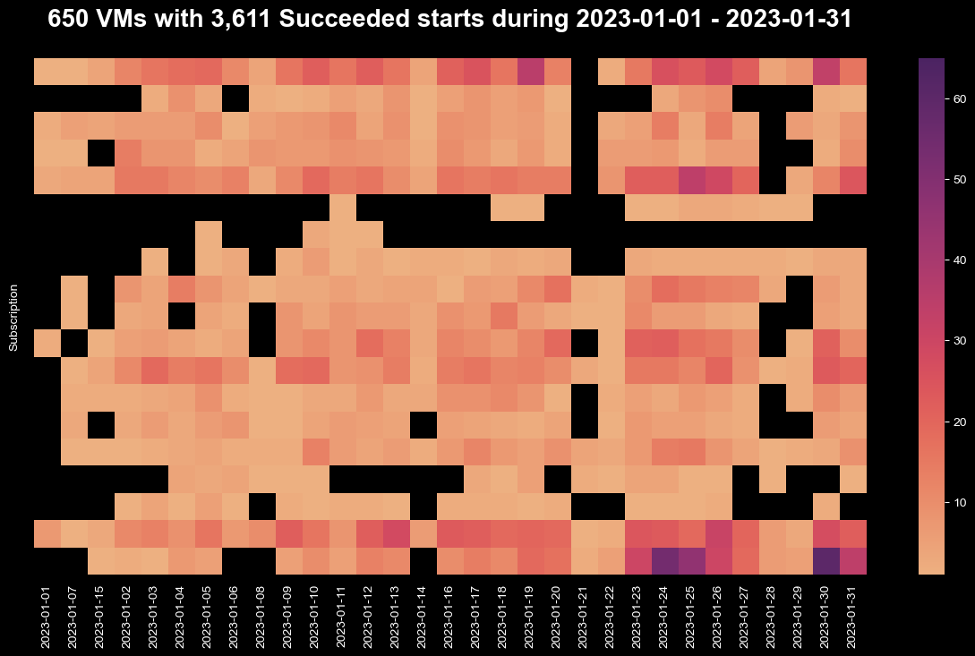

Slide 4
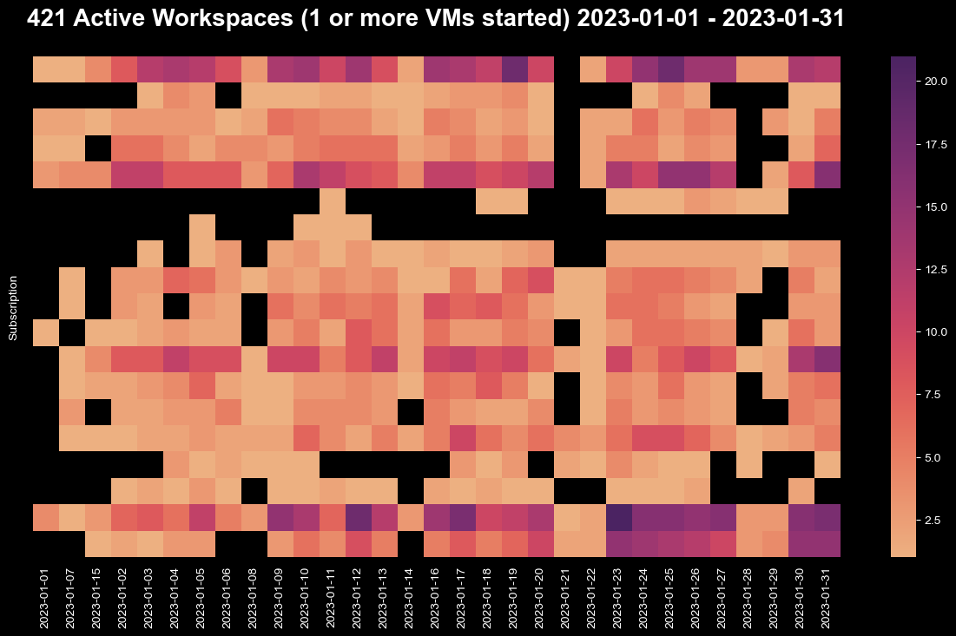

Slide 5
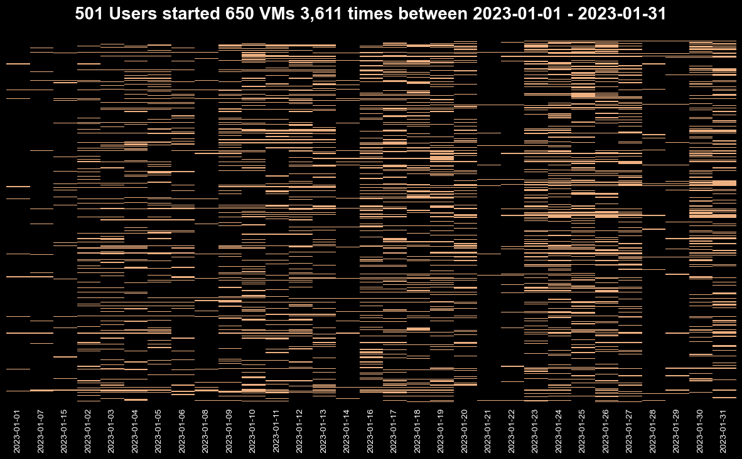

Slide 6
